Slide 1
Muhammad ramadhani
E41242025 GOL E

Slide 2
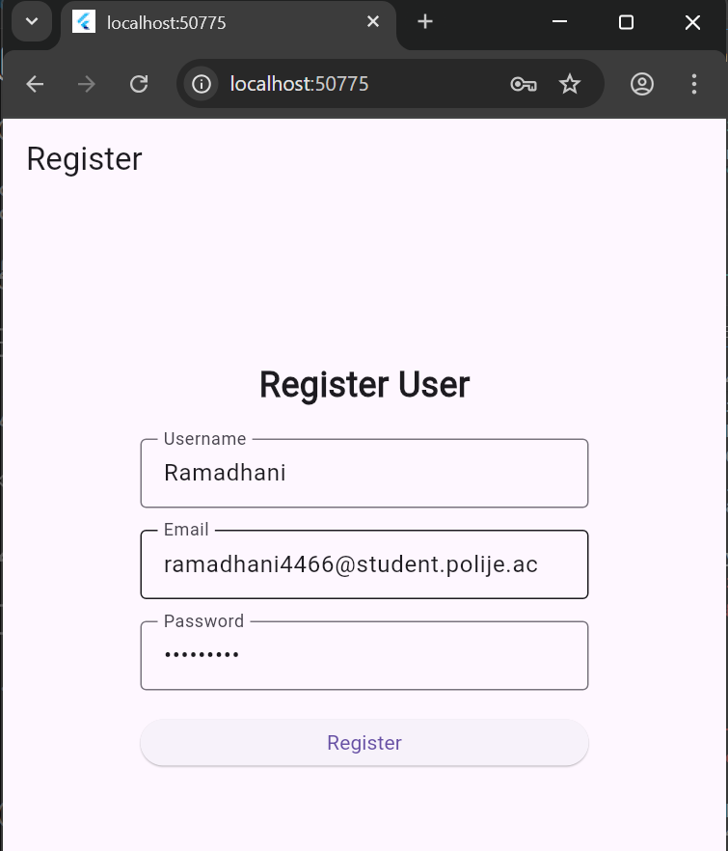
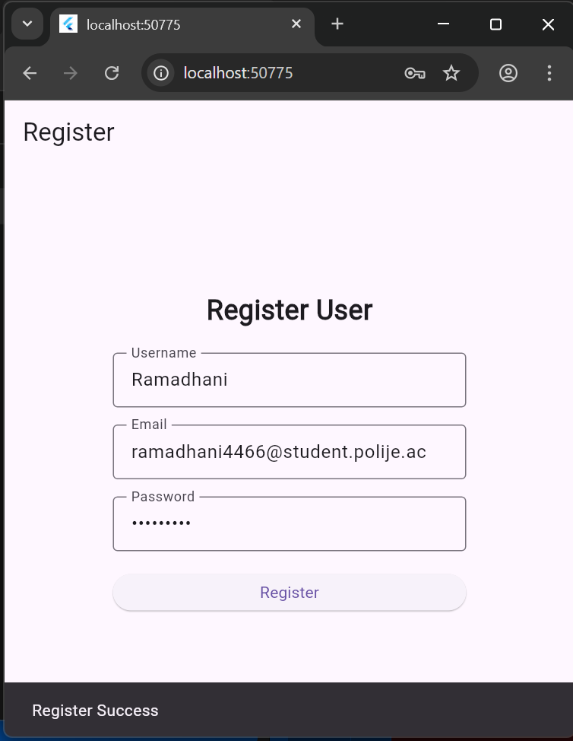

Slide 3


